Slide 1


Slide 2
Contents
Introduction
Lexical analysis
Syntax analysis
Symbol tables

Slide 3
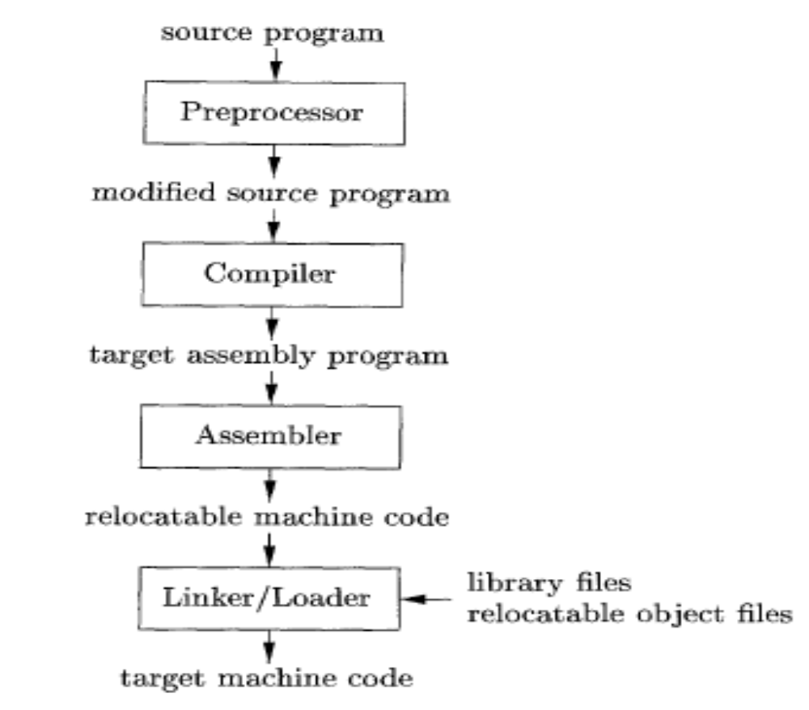
Introduction
Language processing system
Collecting the source
Program ( modules, macros, etc.)
Assembly-language program

Slide 4
Introduction
In order to reduce the complexity of designing and building computers, nearly all of these are made to execute relatively simple commands (but do so very quickly).
A program for a computer must be built by combining these very simple commands into a program in what is called machine language.
Most programming is done using a high-level programming language -> But this language can be very different from the machine language that the computer can execute.
===>This is where the compiler comes in

Slide 5
Introduction
Using a high-level language for programming has a large impact on how fast programs can be developed:
  Compared to machine language, the notation used by programming languages is closer to the way humans think about problems,
  The compiler can spot some obvious programming mistakes,
  Programs written in a high-level language tend to be shorter than equivalent programs written in machine language
  The same program can be compiled to many different machine languages and, hence, be brought to run on many different machines.

Slide 6
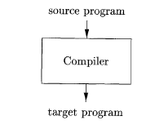
Introduction
What’s a compiler ?
A compiler translates a program written in a high-level programming language that is suitable for human programmers into the low-level machine language that is required by computers
+
spots and reports obvious programmer mistakes.

Slide 7

Running the target program
Introduction
If the target program is an executable machine-language program, it can then be called by the user to process inputs and produce outputs.

Slide 8
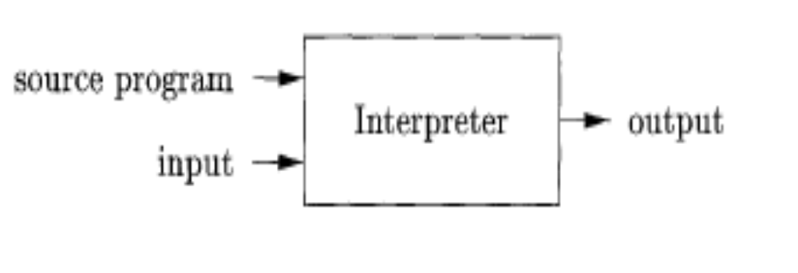
What’s an interpreter ?
Introduction
An interpreter is another way of implementing a programming language.
Interpretation shares many aspects with compiling (Lexing, parsing and type-checking)
➔ But
Instead of producing a target program as a translation, an interpreter appears to directly execute the operations specified in the source program on inputs supplied by the user

Slide 9
Compiler vs. Interpreter
Introduction
An interpreter may need to process the same piece of the syntax tree (for example, the body of a loop) many times ➔ interpretation is slower than executing a compiled program.
An interpreter executes the source program statement by statement ➔ it can usually give better error diagnostics than a compiler.

Slide 10
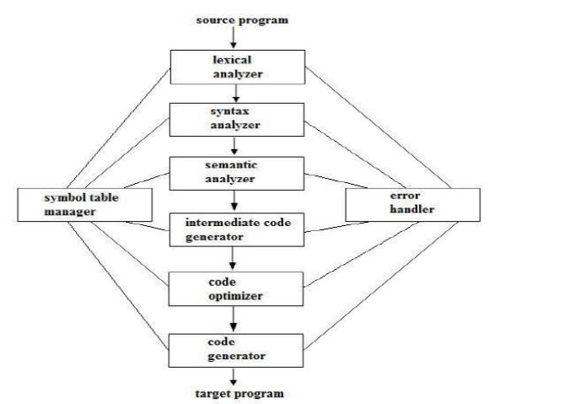
The Structure of a Compiler

Slide 11
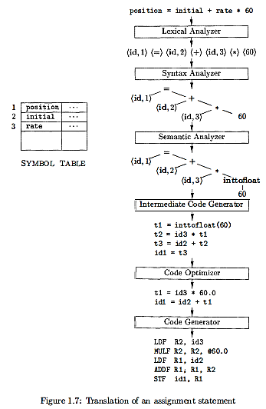

Slide 12
Symbol Table Management
Introduction
- The symbol table is a data structure containing a record for each variable name, with fields for the attributes of the name (storage allocated for a name, its type, its scope where in the program its value may be used), and for procedure names (number and types of its arguments, the method of passing each argument and the type returned ).
- The data structure should be designed to allow the compiler to find the record for each name quickly and to store or retrieve data from that record quickly.

Slide 13
Symbol Table Management( Contd.)
Purpose of the symbol table:
To store the names of all entities in a structured form at one place.
To verify if a variable name has been declared.
To verify type checking by verifying assignments and expressions in source code is semantically correct.
Scope resolution.

Slide 14
Symbol Table Operations
The main operations in a symbol table are as follows:
Allocate- To allocate space for a new symbol table.
Insert- To insert a symbol in a symbol table.
Ex: int x; -------- the compiler should prcess it as (x,int)
Free- To free the storage of a symbol table.

Slide 15
Symbol Table Operations(Contd.)
Lookup- To search for a name and return a pointer to its entry. It consists of:
The existence of symbol in the table.
Declaration of the symbol before it is used.
Initialization of the symbol.
Checking whether the symbol is used multiple times.
Basic Format: lookup(symbol)

Slide 16
Symbol Table Operations(Contd.)
Get_attribute- To get an attribute associated with a given entry.
Set_attribute- To associate an attribute with a given entry.

Slide 17
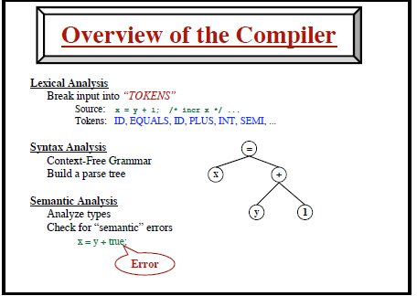
Introduction
Example

Slide 18
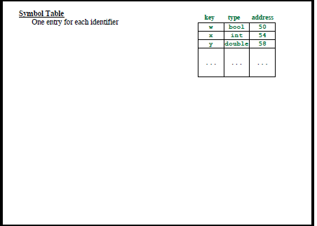
Introduction

Slide 19
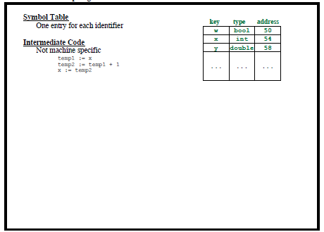
Introduction

Slide 20
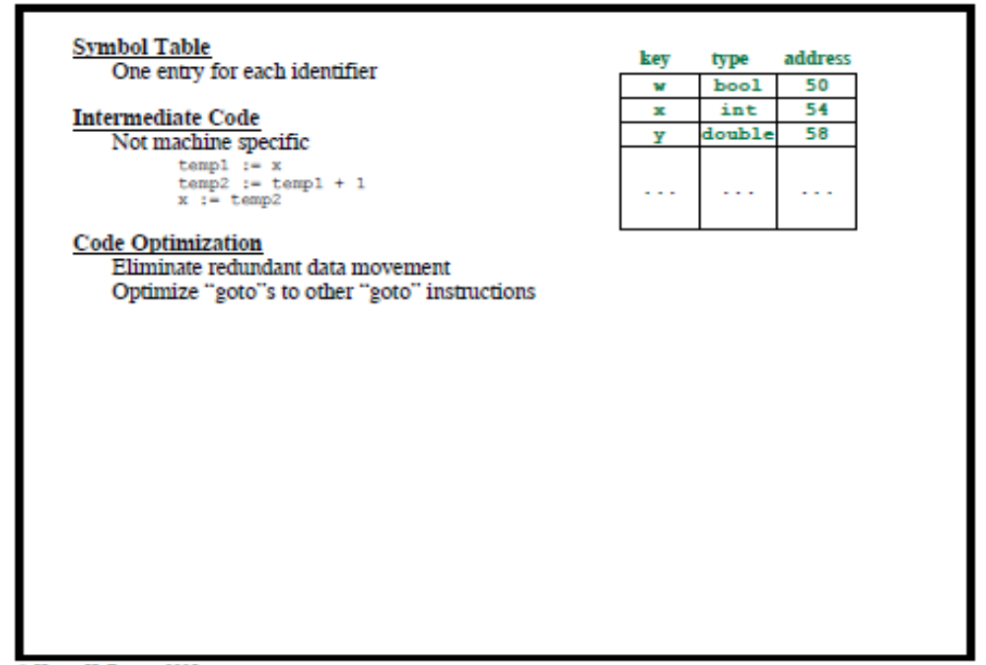
Introduction

Slide 21
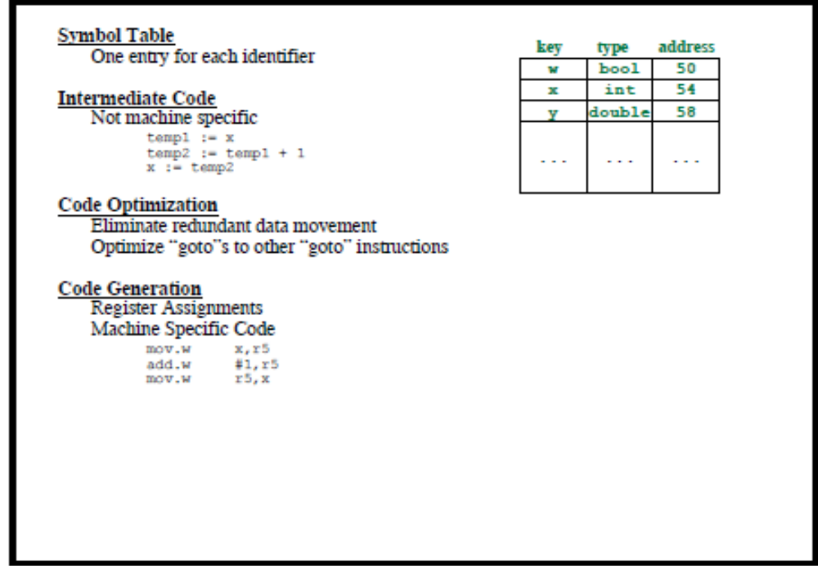
Introduction

Slide 22
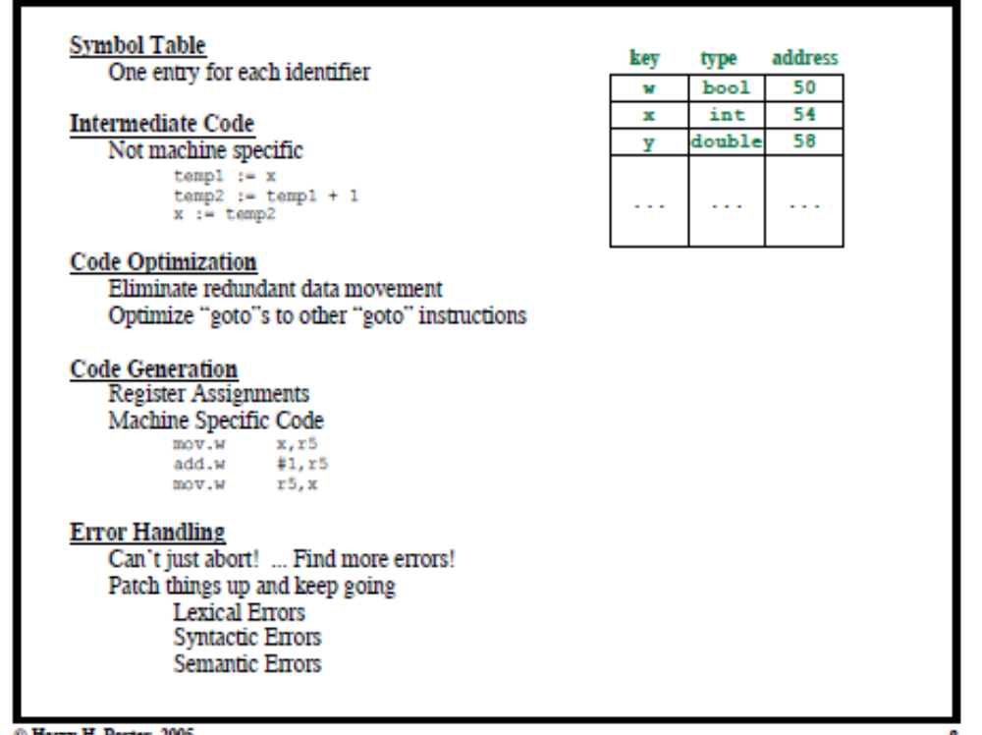
Introduction

Slide 23
Introduction
Intermediate Code Generation
In the process of translating a source program into target code, a compiler may construct one or more intermediate representations, which can have a variety of forms.
It should be easy to
produce
It should be easy to translate into the target machine.

Slide 24
Introduction
Code Optimization
The machine-independent code-optimization phase attempts to improve the intermediate code so that better target code will result.
faster
shorter code
target code
that consumes less power

Slide 25
Introduction
Code Generation
The code generator takes as input an intermediate representation of the source program and maps it into the target language.
A judicious assignment of registers to hold variables.

Slide 26
In an implementation, activities from several phases may be grouped together.
Introduction
The Grouping o f Phases into Passes
- Front-end phases : {lexical analysis, syntax analysis, semantic analysis, and intermediate code generation }( one pass)
- Back-end phases : {code generation, aspects of code optimization, error handling , symbol-table operations}
N.B: Several phases of compilation are ususally implemented in a single pass → reading an imput file and writing an output file.

Slide 27
Introduction
Compiler- Construction Tools
The compiler writer, like any software developer, can profitably use modern software development environments containing tools such as language editors, debuggers, version managers , profilers, test harnesses, and so on.
In addition to these general software-development tools, other more specialized tools have been created to help implement various phases of a compiler.

Slide 28
Compiler-construction tools examples
Introduction
Parser generators (to produce syntax analyzers)
Scanner generators (to generate automatically lexical analyzers)
Syntax-directed translation engines (producing routines that walk the parse tree)
Code-generator (taking rules that define the translation of each operation of the intermediate language into the machine language for the target machine)
Data-flow analysis engines ( optimizing code)
Compiler- construction toolkits

Slide 29
The Evolution of Programming Languages
The Move to Higher-level Languages
Impacts on Compile

Slide 30
The Science of Building a Compiler
Modeling in Compiler Design and Implementation
The Science of Code Optimization
  Compiler optimizations must meet the following design objectives:
    The optimization must be correct, that is, preserve the meaning of the compiled program,
    The optimization must improve the performance of many programs,
    The compilation time must be kept reasonable, and
    The engineering effort required must be manageable.

Slide 31
Applications of Compiler Technology
Implementation of High-Level Programming Languages
  The key ideas behind object orientation are
    1 . Data abstraction and
    2. Inheritance of properties,
Optimizations for Computer Architectures
  Parallelism
  Memory Hierarchies

Slide 32
Design of New Computer Architectures
  RISC
  CISC
  Specialized Architectures

